Slide 1
DDS Analytics
Factors that lead to Employee Attrition
Analysis and Presentation by:
Adam Canton

Slide 2
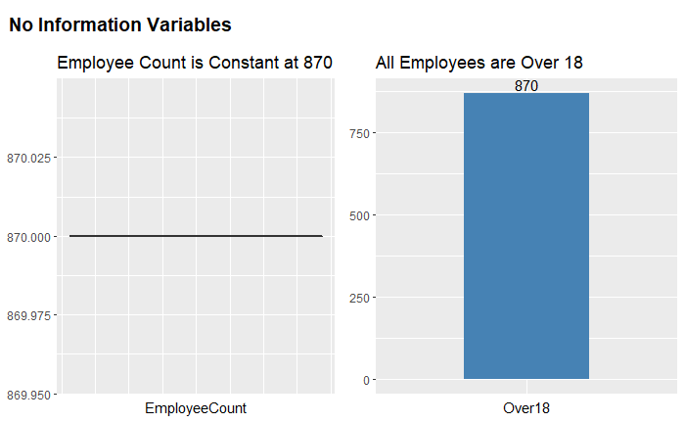
The Dataset
870 observations of 36 variables (9 categorical, 27 continuous)
Including the response – Attrition status of the employee
2 variables give no information
Further, the ID column was removed as it was being selected.

Slide 3
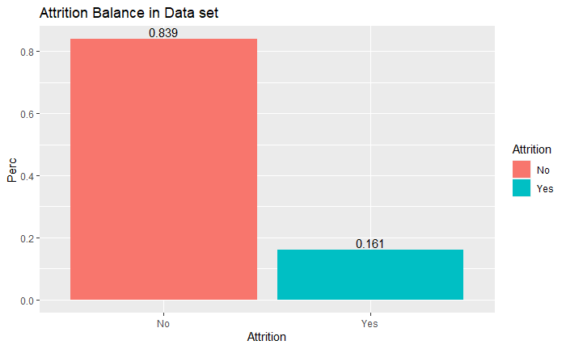
The Response - Attrition
Attrition accounts for approximately 16% of the data set, or 140 observations versus the 84% who are still at Frito Lay which compromises the other 730 individuals.
Sampling method forced a 50/50 split of Attrition Status – 100 Yes and 100 No.

Slide 4
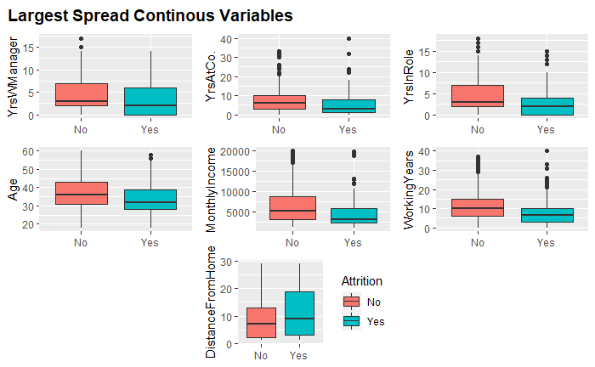
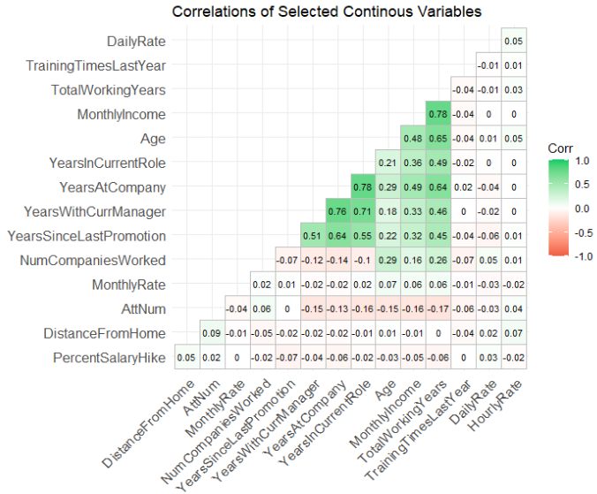
Exploratory Analysis – Continuous Variables

Slide 5
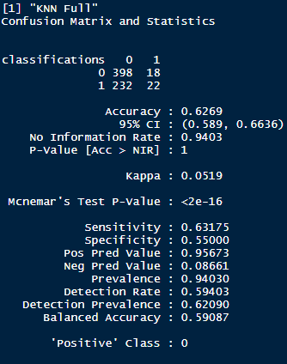
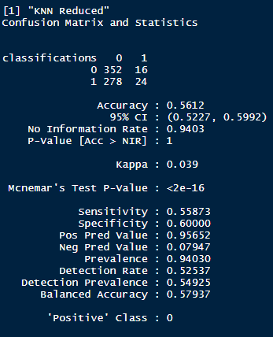
KNN Models – The Continuous Variables alone are not optimal predictors of Attrition
Two Models –
Full: With all continuous Variables
Reduced: With only the 7 strongest continuous variables

Slide 6
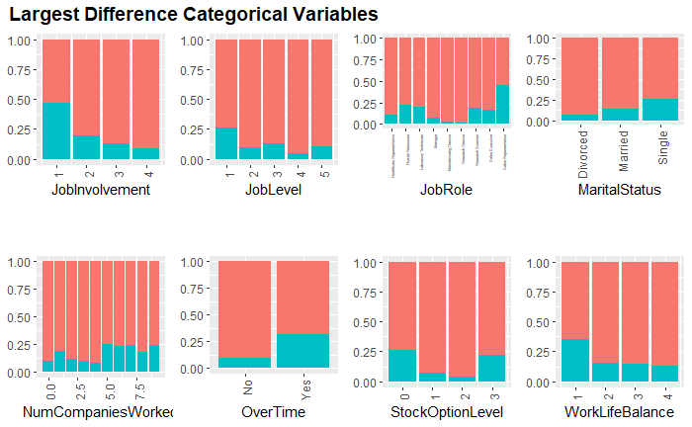
Exploratory Analysis – Categorical Variables

Slide 7
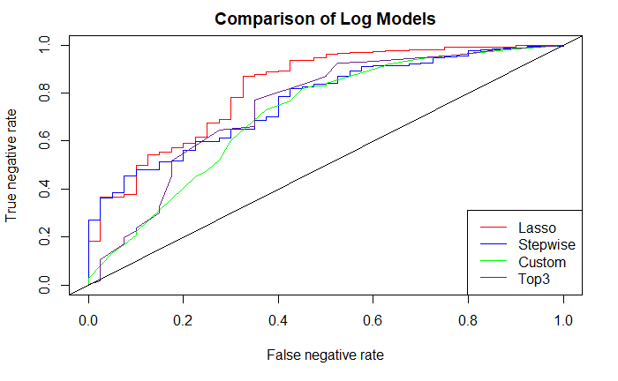
Logistic Regression Models Performance - Single Sample
Step Model:
Ran step selection on the 15 strongest variables by inspection - based on model AIC
Poorest performing Model – dropped from CV runs
Lasso Model:
Lasso selection on the full data set, with auto-selected minimum lambda
Most consistent model through relevant metrics and through CV runs
Custom Model:
A manually iterated process where I started from a single variable and manually selected variables in and out based on Accuracy, Sensitivity, and Specificity.
Top3 Model:
Model selected out of the best performing 3-member subset for predicting Attrition of the top 15 variables iterated through the custom model

Slide 8
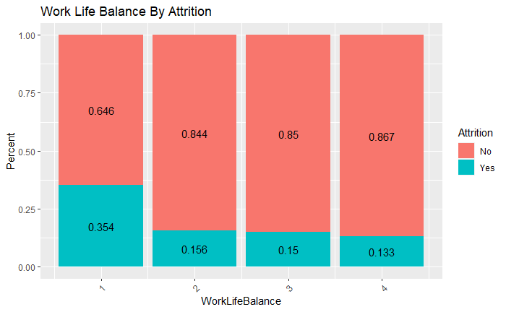
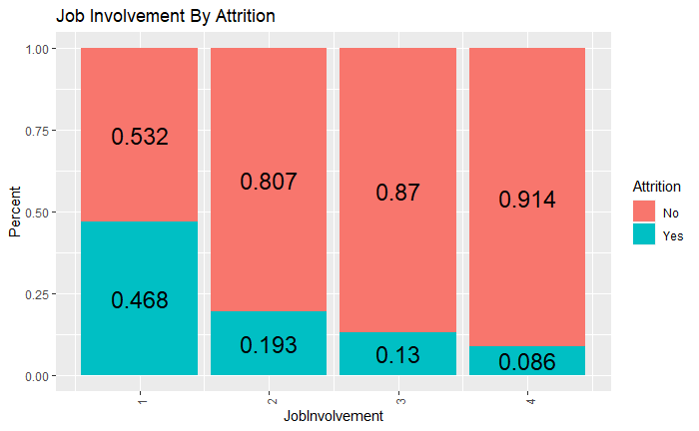
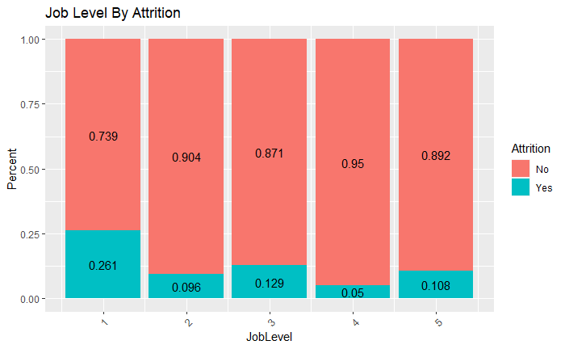
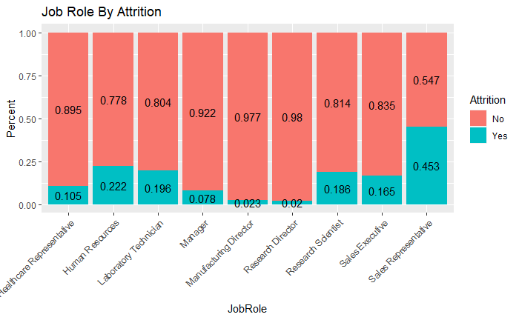
The Top 3 Model - Creation
The best 3 member subsets taken from iterations through the custom model
Marital Status and Over Time were locks. 3rd variable is a bit harder to pin down.
Job Role, Job Level, Work Life Balance, or Job Involvement?

Slide 9
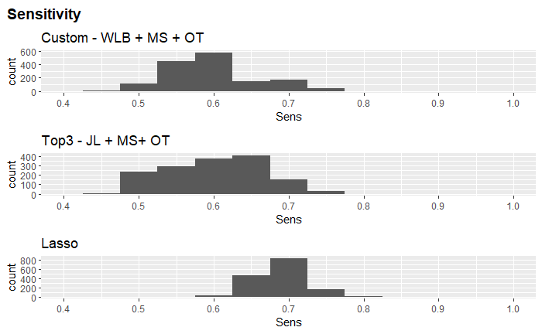
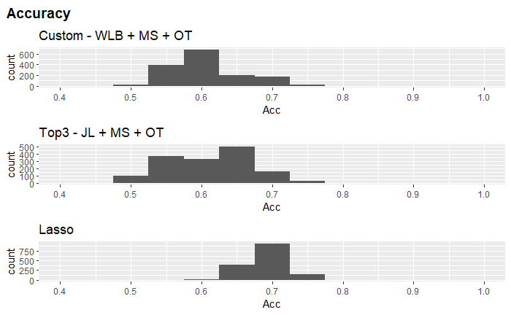
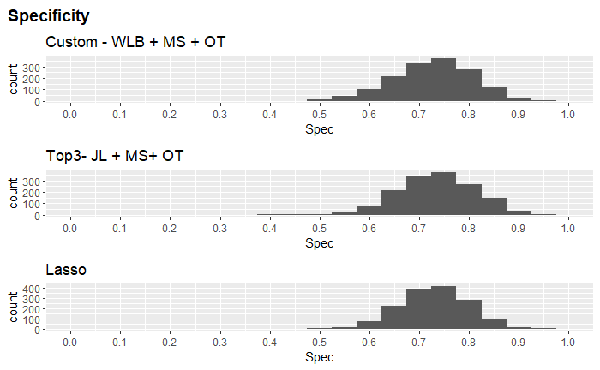
Top 3 Model Comparisons: Cross Variation – 1500 shuffles
Becomes a question of which you find most valuable – consistency or ability to identify attrition at the expense of our sensitivity.
The top 3 variables leading to Attrition are:
Job Level: especially the lower levels
Marital Status: Single and Divorcees
Over Time: 3x increase in percent attrition for OT workers
Other Model Comparisons in Appendix slides

Slide 10
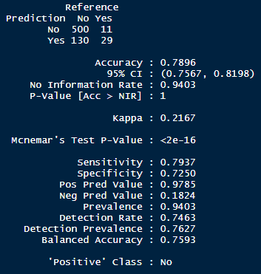
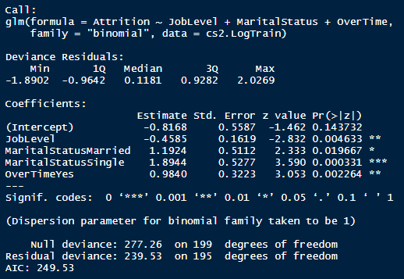
Conclusion
The top 3 variables leading to Attrition are:
Job Level: especially the lower levels
Marital Status: Single and Divorcees
Over Time: 3x increase in percent attrition for OT workers
 |  |  |  |  |  |  | Exponentiated
Parameter | estimate | SE | tcrit | lower | upper |  | Low |  | High
Int | -0.8168 | 0.5587 | 1.96 | -1.91185 | 0.278252 |  | 0.147806396 |  | 1.320819
JobLevel | -0.4585 | 0.1619 | 1.96 | -0.77582 | -0.14118 |  | 0.460324317 |  | 0.868336
Married | 1.1924 | 0.5112 | 1.96 | 0.190448 | 2.194352 |  | 1.209791463 |  | 8.974184
Single | 1.8944 | 0.5277 | 1.96 | 0.860108 | 2.928692 |  | 2.363415929 |  | 18.70315
OT Yes | 0.984 | 0.3223 | 1.96 | 0.352292 | 1.615708 |  | 1.422323782 |  | 5.031449
Reference Levels
 | Marital Status: | Divorced
 | OT: | No

Slide 11
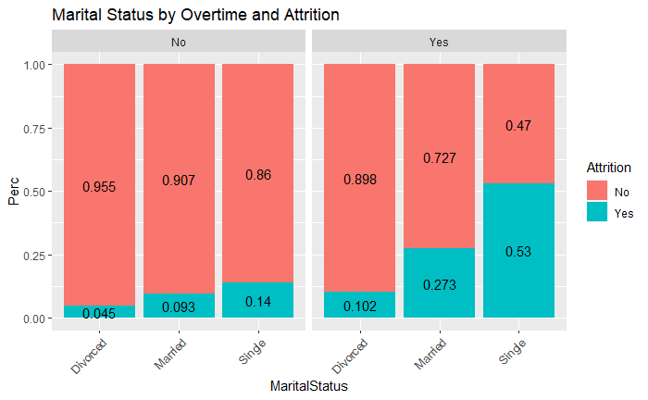
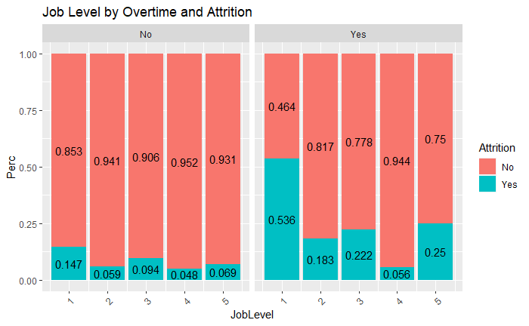
Interesting Finds - Over Time Effects

Slide 12
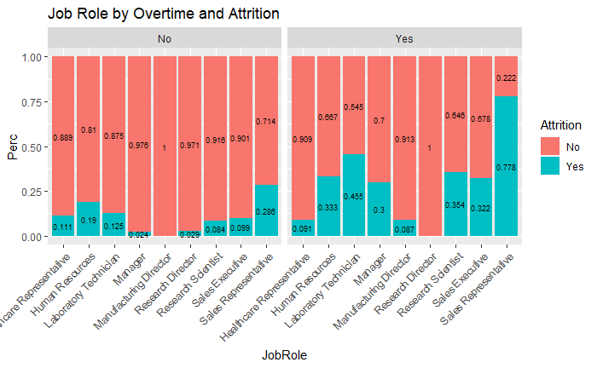
Interesting Finds - Over Time Effects

Slide 13
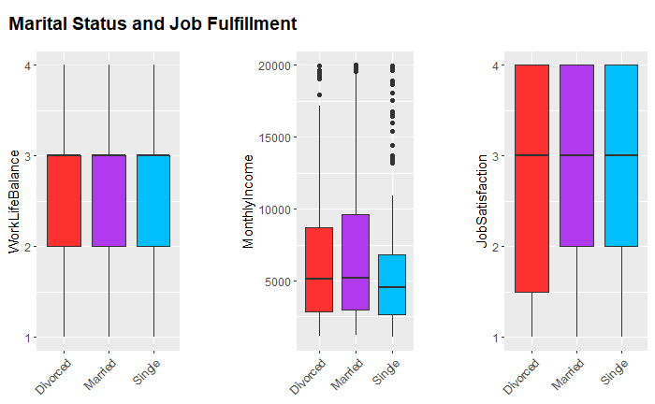
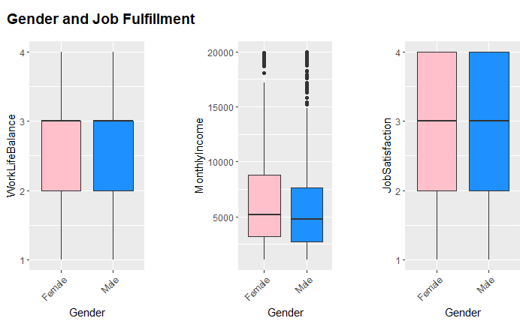
How fulfilled are the employees?
“Personal fulfillment is number one aspect of employee satisfaction”
What Matters Most?

Slide 14
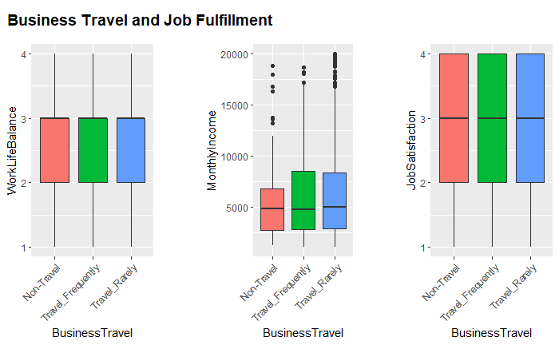
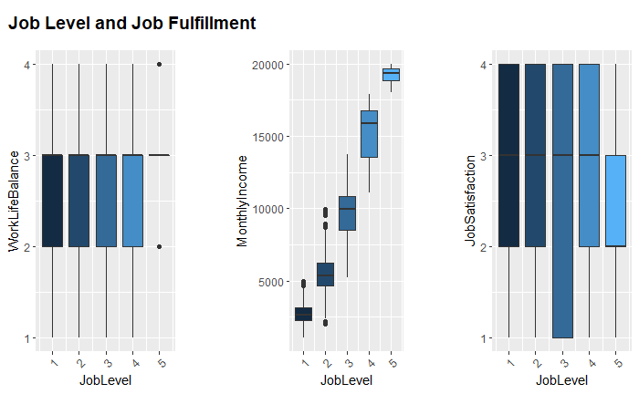
How fulfilled are the employees?

Slide 15
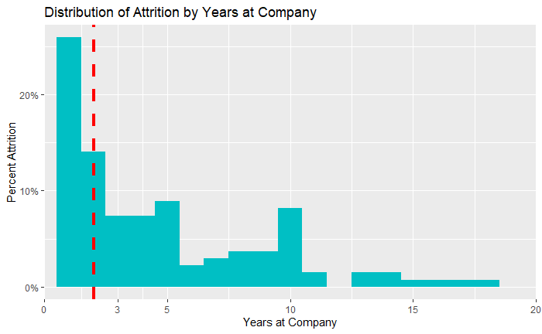
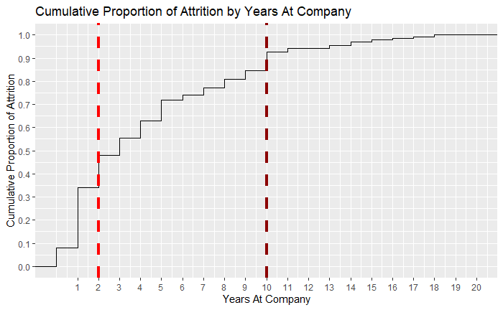
Of those who leave when do they do it?

Slide 16
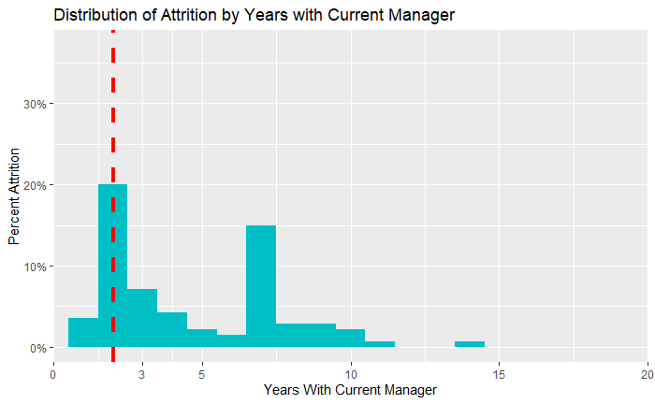
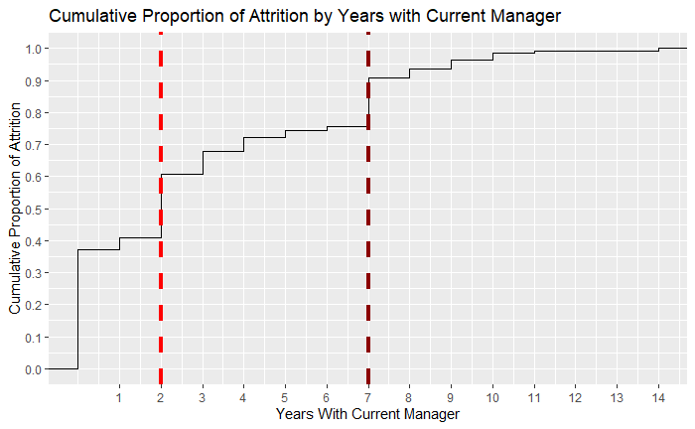
Of those who leave Why - Managers?

Slide 17
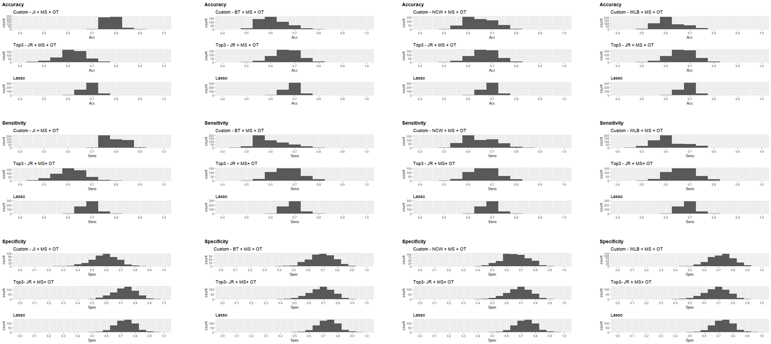
Appendix I – Other model Comps

Slide 18
